Slide 1

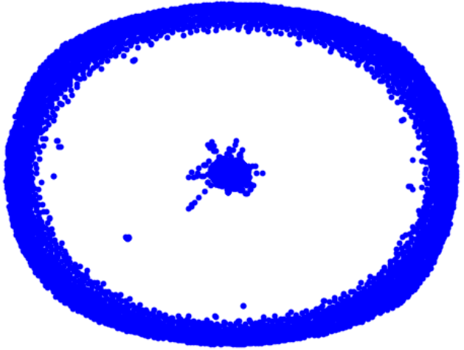
Capstone Project Phase B Graph Generation using Graph U-Nets
24-1-R-4
Yana Raitsin | Hanil Zarbailov
Supervisor: Dr. Renata Avros

Slide 2
Agenda
Project's Goals
Background
Solution Overview
Results & Analysis
Development Process
Challenges & Solutions
Evaluation of Project Benchmarks

Slide 3
Project's Goals

Slide 4
Project's Goals Need For The Project
A new approach for graph simulation using Graph U-Nets.
Improve upon Misc-GAN's efficiency and precision.
Fine-tune graph generation upon given prototypes.

Slide 5
Background

Slide 6
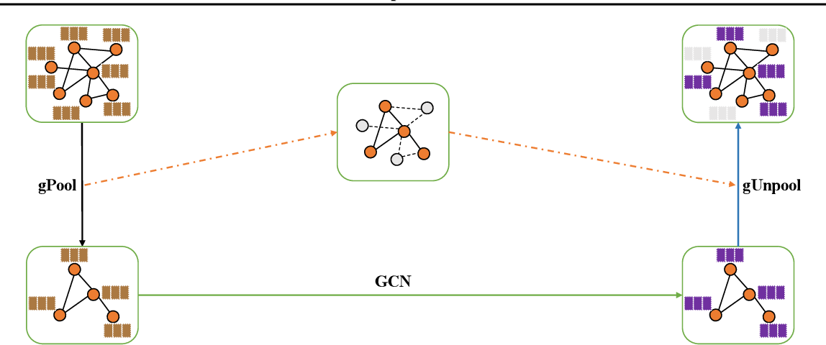
Graph U-Nets
An adaption of U-Net architecture for graph-structured data.
Key Components:
Graph Convolutional Layers: Perform convolution operations on graphs to capture local structures.
Pooling and Unpooling Layers: Coarsen and reconstruct graphs, preserving essential structures.
Skip Connections: Retain important features and improve gradient flow by connecting downsampling and upsampling paths.

Slide 7
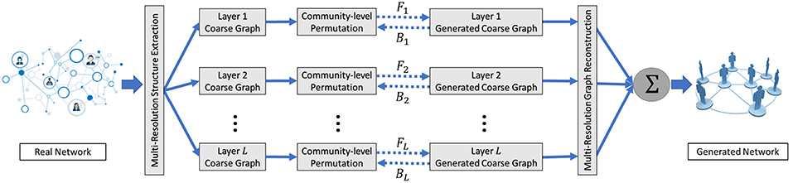
Misc-GAN
Sophisticated graph generation model – referencing model.
Captures complex relationships and hierarchies.
The architecture:
Multi-Scale Graph Representation Module.
Graph Generation Module.
Graph Reconstruction Module.

Slide 8
Background The Problem
The Problem with the Misc-GAN Model
Uses a statistical module for coarsening and reconstructing graphs.
Has limitations in graph generation precision.
Notes:
We took Misc-GAN as the base of our new approach in order to improve upon it

Slide 9
Solution
Overview

Slide 10
Solution Overview
Use Cycle-GAN to simulate synthetic coarse graphs at each granularity level.
Merge all synthetic coarse graphs into one final graph using G-Unpool of the trained Graph U-Nets and the Multi-Scale Graph Reconstruction module.
Training of a Graph U-Nets on a given underlying source graph(e.g., DBLP, PROTEINS).
Pre-Processing on a target graph(CORA, PubMed) to extract crucial data.
Coarsening graphs on different granularity levels using G-Pool operation of the trained Graph U-Nets.

Slide 11
Solution Overview Added Value
Our new approach uses Graph U-Nets to base coarsening and reconstructing upon node features (pooling).
The trained network is a new input parameter to the Misc-GAN model.

Slide 12
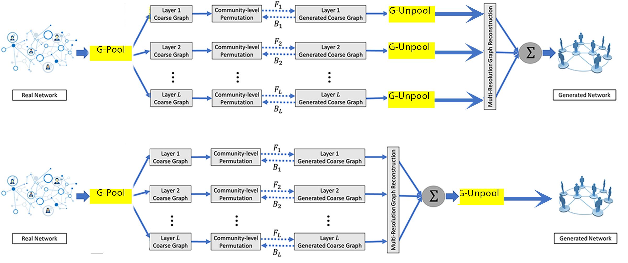
Solution Overview Architecture
I
II

Slide 13
Solution Overview Pre-Training
Allows us to fine-tune the model by training a Graph U-Nets on a dataset.
Datasets we used:
PROTEINS
DBLP
COLLAB
Notes:
Explain about datasets

Slide 14
Solution Overview Simulation Using Graph U-Nets
Simulate a target dataset using a Graph U-Nets network trained on another dataset.
Different combinations yield different results.
Datasets we used:
CORA
PubMed
Notes:
Explain about datasets

Slide 15
Results & Analysis

Slide 16
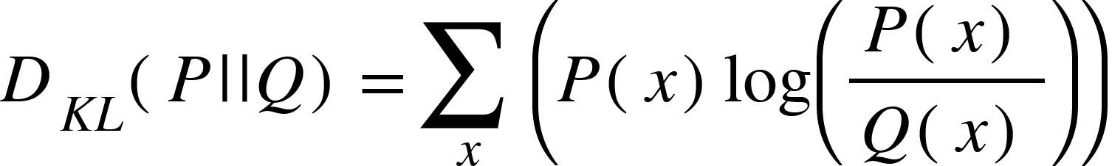
Background
Proximity Measures between generated graph and real graph distributions.
Identifies lack of diversity in generated graphs.
Evaluate the model's ability to generate unseen, realistic graphs.
Generally – Smaller means better.
Degree/Coefficient KL Divergence

Slide 17
Results & Analysis Explanation
The experiments' goals:
Comparison of the two approaches.
Metrics:
Degree KL Divergence
Coefficient KL Divergence
Cora
12 chunks of PubMed.
In total – 78 experiments.

Slide 18
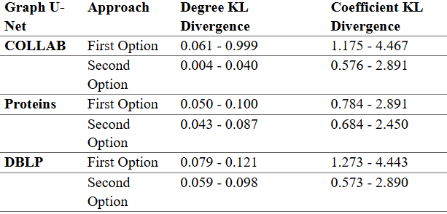
Results & Analysis PubMed

Slide 19
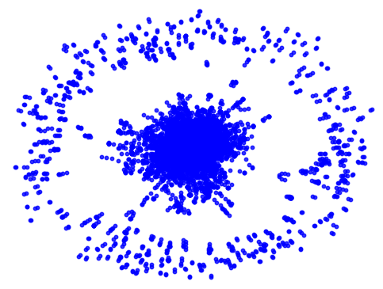
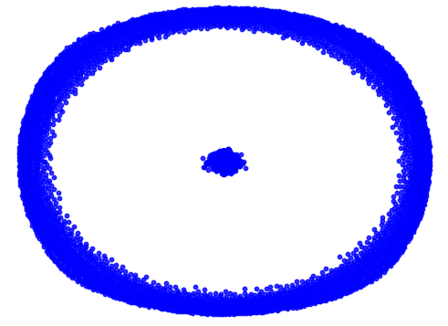
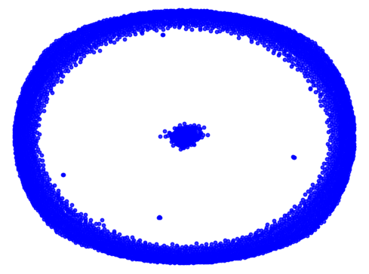
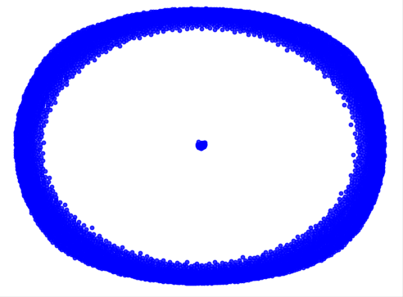
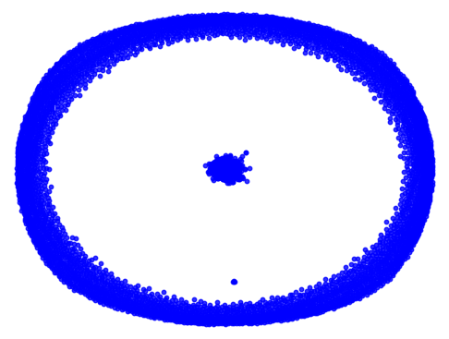
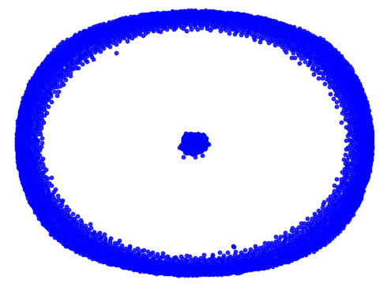
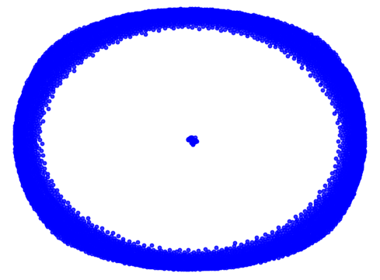
Simulated Graphs PubMed
Original
DBLP
PROTEINS
COLLAB
First
Option
Second
Option

Slide 20
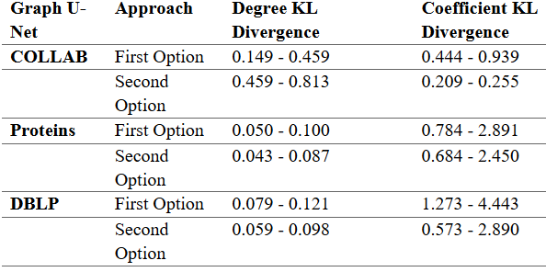
Results & Analysis CORA

Slide 21
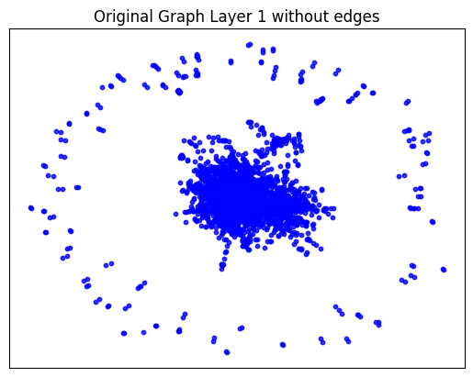
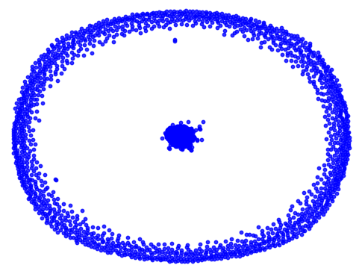
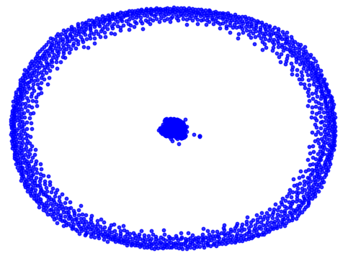
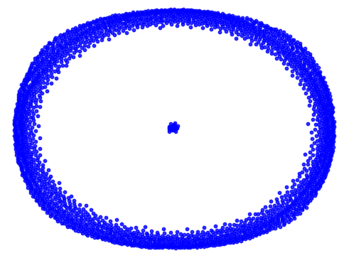
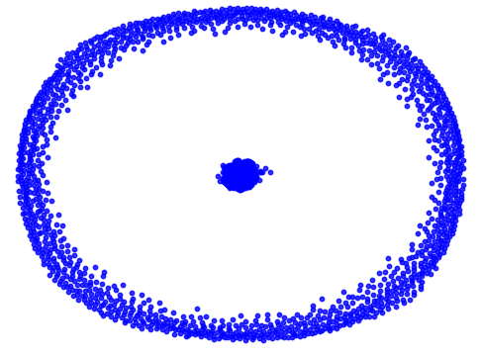
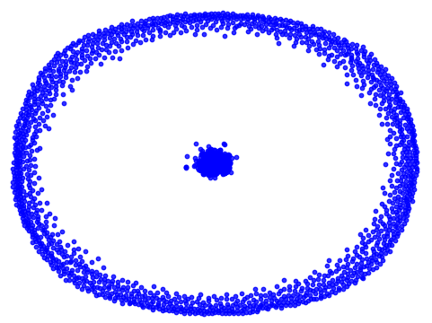
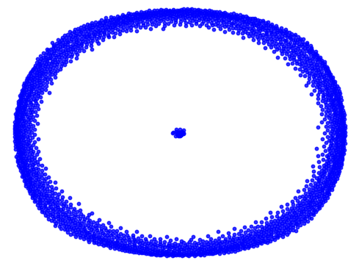
Simulated Graphs CORA
Original
DBLP
PROTEINS
COLLAB
First
Option
Second
Option

Slide 22
Results & Analysis Conclusions
Better results over Misc-GAN.
Second option wins.
Need more investigation and experiments to improve model.

Slide 23
Development Process
Researched Misc-GAN and explored the authors' GitHub repository.
Ran the code locally and discovered it's too slow and demanding.
Transitioned into Google Colab and began conducting first experiments.
Researched Graph U-Nets & integrated it into the model.

Slide 24
Challenges & Solutions

Slide 25
Challenges & Solutions
Low Memory on Local Machines
Access to better GPU, CPU, and RAM.
Rewriting Misc-GAN's Pre-Processing Module in Python
Took long, but worth it.
Handling Large Datasets
Partitioned datasets into smaller chunks.
Enabled more experiments, enhancing robustness.
Moved to Google Colab Pro.
Rewrote the pre-processing module entirely in Python.

Slide 26
Evaluation of Project Benchmarks

Slide 27
Evaluation of Project Benchmarks
Met and exceeded benchmarks despite challenges.
Improved upon Misc-GAN.
Handled tight deadlines.
Determined the best method.

Slide 28
Thanks!
Any Questions?

